Slide 1
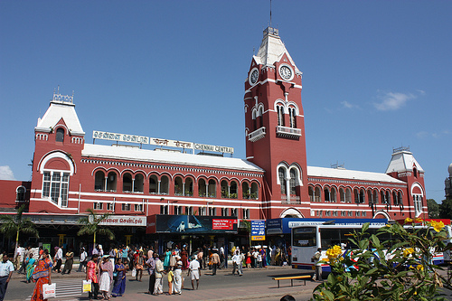

OpenStack foundation
global meetup Chennai, 19/09/12

Slide 2
Agenda

Slide 3


Slide 4
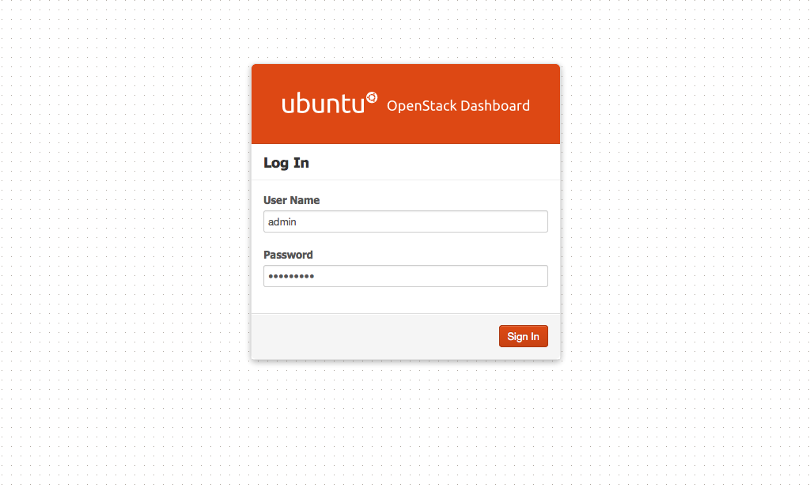

Slide 6
About OpenStack.
http://www.openstack.org
@openstack

Slide 7
About OpenStack India.
http://www.meetup.com/Indian-OpenStack-User-Group/
http://www.slideshare.net/openstackindia
@openstackindia

Slide 8
Thanks.
Atul Jha
@koolhead17
Chennai station photo courtsey : http://bit.ly/PRowzD

